Slide 1

Advanced Software Development Final Project Flight-Gear Simulator Controller
Course number: #600098 Lecturer: Dr. Eliahu Khalastchi Developers: Gal Jacobson & Roey Miller

Slide 2
Introduction
In this presentation, we will review our end of semester project that we developed during the ‘Advanced Software Development’ course, which deals with Java programming, with emphasis on design patterns and programming principles such as SOLID and GRASP. In this project, we built a desktop application using Java, to control a known flight simulator and made it more accessible and user friendly.

Slide 3
Project Milestones
Simple server solver – using smart cache-manager and file streaming
Custom language interpreter using lexical analysis and syntax analysis
1
2
3
4
5
FINAL VERSION Done.
General design of server side’s architecture using GRASP and SOLID principles
Implementation of BFS and A-Star algorithms in the solver server
Designing and building a Graphic User Interface (GUI) to the simulator using JavaFX

Slide 4
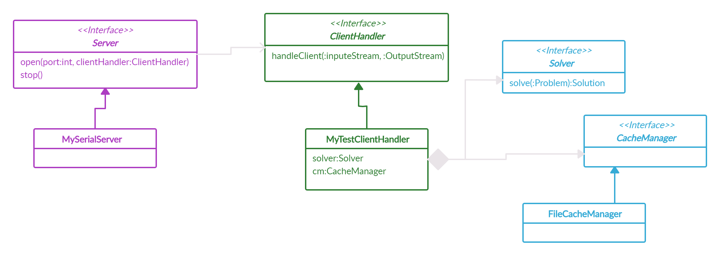
The Server Side

Slide 5
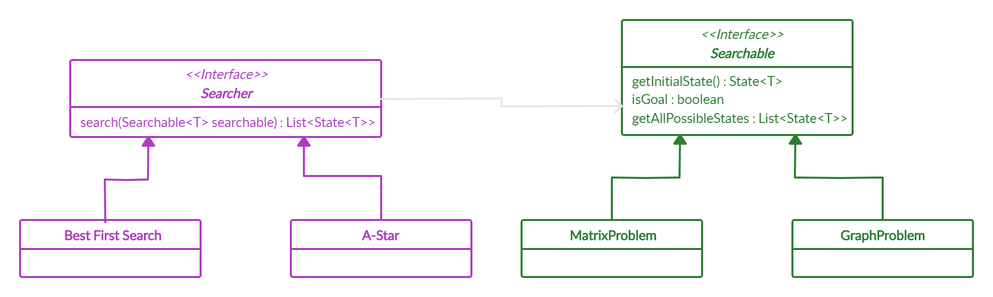
The Server Side
Our Concrete Server
Given a graph, it could solve it using BFS and A-Star algorithms

Slide 6
The Script Reader
Lexer
Pre-Parser
Parser
Lexical Analyzer
Syntax Analyzer
Semantic Analyzer

Slide 7
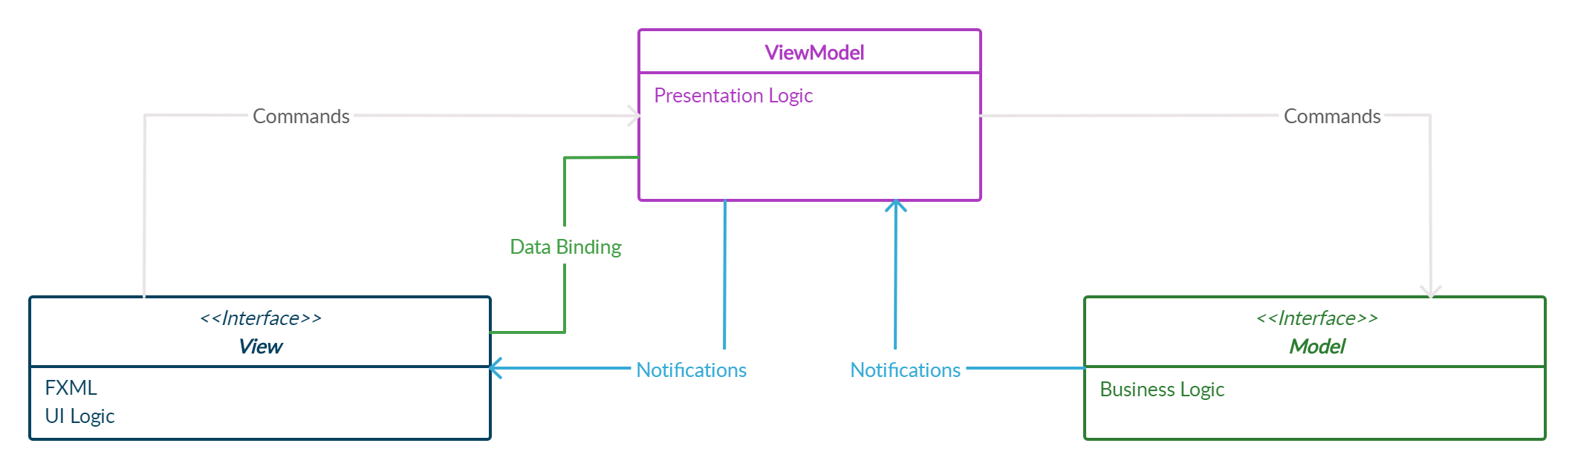
JavaFX GUI
With MVVM Architecture
Extensibility
Has the ability to replace or add new pieces of the code.
Testability
Make sure it works right when written and keeps working even when things change in maintenance.
Maintainability
A clean separation between different kinds of code.
Cause moving out new releases quickly.

Slide 8

The Team
Thank you for watching!
Gal Jacobson
Roey Miller
B.Sc. Compute Science Student 2ND year
B.Sc. Compute Science Student 2ND year
Gal Jacobson
Roey Miller
Jacobsongal@gmail.com
roeymillerp401@gmail.com
JacobsonGal
RoeyMiller

